Slide 1
Software Engineering and Architecture
Maintainability & Flexibility

Slide 2
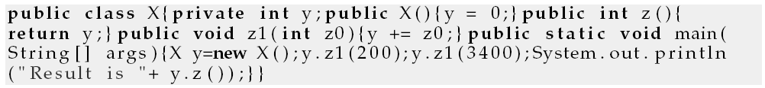
What is this?
So – what is this program?
What does it do?
What every-day abstraction is this code implementing?

Slide 3
Another example
Look at this C program
int a[1817];main(z,p,q,r){for(p=80;q+p-80;p-=2*a[p])for(z=9;z--;)q=3&(r=time(0) +r*57)/7,q=q?q-1?q-2?1-p%79?-1:0:p%79-77?1:0:p<1659?79:0:p>158?-79:0,q?!a[p+q*2 ]?a[p+=a[p+=q]=q]=q:0:0;for(;q++-1817;)printf(q%79?"%c":"%c\n"," #"[!a[q-1]]);}

Slide 4
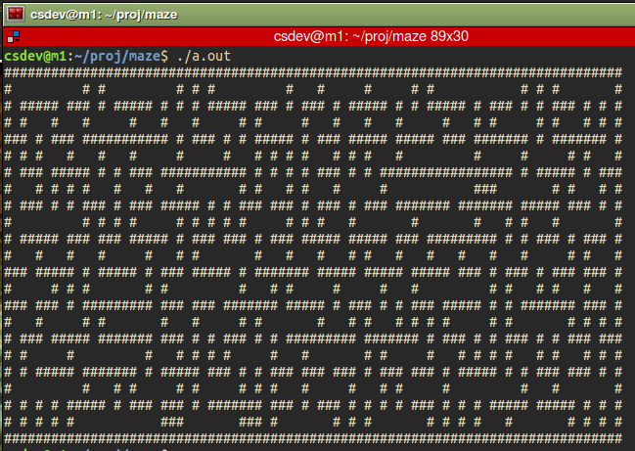
(What does the C program do?)
Process
Paste string into file ‘m.c’
Install ‘gcc’
gcc m.c
./a.out
Done…

Slide 5
The point
The customers / executing software do not care if the code is
Readable / understandable / well documented
As long as it serves its purpose well...
However, developers do
Unless you are about to quit tomorrow
Or in a consulting company ☺

Slide 6
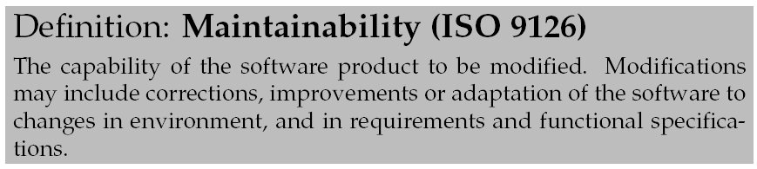
What developers want...
We need software to be maintainable/”Vedligeholdbar”
Maintainability is a quality that our code has to a varying degree
Low maintainability -> high maintainability
Note: ISO 25010 is the newest version but … the same…

Slide 7

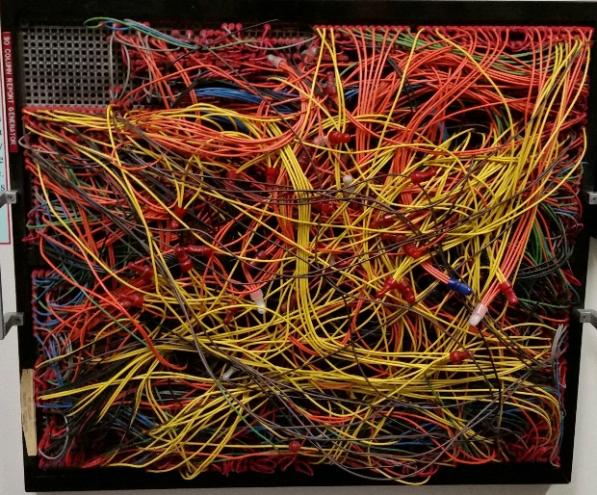
Or else… Technical Debt
Technical Debt or Architectural Erosion
That ‘not-quite-right’ code that is fast to write
If you do not pay your debt, the “interest” you pay becomes unmanageable
AntiPattern
“Big ball of mud”
“Spaghetti code”

Slide 8
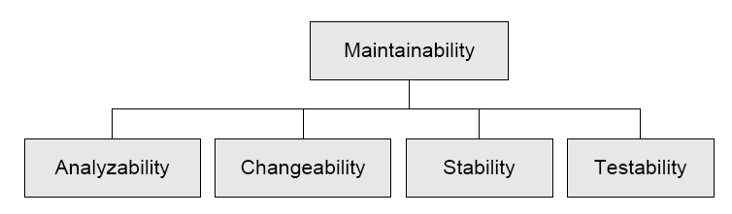
Aspects
Maintainability is influenced by a lot of sub qualities.

Slide 9
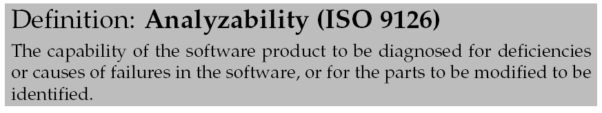
Analyzability
Basically: can I understand the code?
Indentation
Intention-revealing names of methods
Follow language conventions
Useful (!) comments and JavaDoc
Training!
To spot e.g. Design Patterns

Slide 10
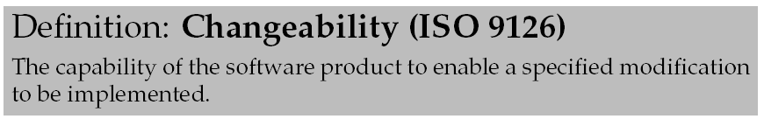
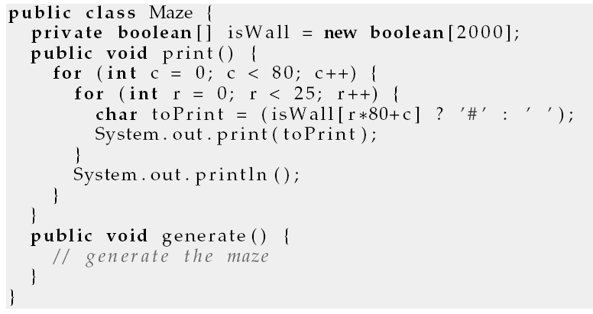
Changeability
Cost of modifying the code
160x45 maze?
“Modificerbarhed”
Magic Constants

Slide 11
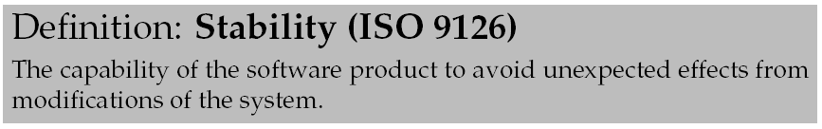
Stability
In BASIC all variables are global
do not store some global property in variable i !
Why not?
What ‘stability’ enhancing features have Java?
Notes:
Encapsulation and Scoping are central language constructs to enhance stability of code

Slide 12
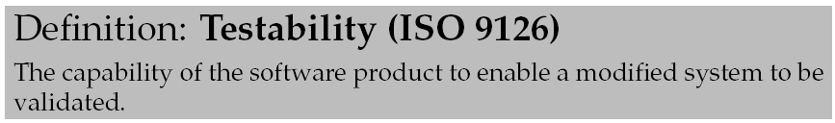
Testability
Everything can be tested – right?
Not always… Or too tedious to do…
Ariane 5 rocket guidance system bug
Found when they launched it...
Overflow error due to 64-bit to 16-bit conversion
Error => switched to backup computer – with the same data !
Increasing testability is a major learning goal in SWEA
Test doubles…
500 million $
Notes:
So, what exactly happened?
A 64-bit floating point number relating to the horizontal velocity of the rocket with respect to the platform was converted to a 16 bit signed integer. The number was larger than 32,767, the largest integer storable in a 16 bit signed integer, and thus the conversion failed.
The software ended up triggering a system diagnostic that dumped its debugging data into an area of memory being used by the programs guiding the rocket’s motors. At the same time, control was switched to a backup computer that unfortunately had the same data.
This was misinterpreted as necessitating strong corrective action and the rocket’s motors swiveled to the limits of their mountings. Disaster ensued. [https://itsfoss.com/a-floating-point-error-that-caused-a-damage-worth-half-a-billion/]

Slide 13
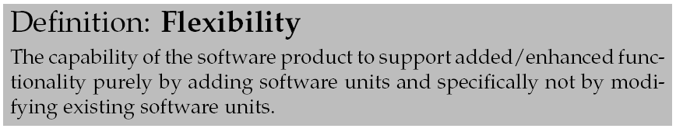
Flexibility
A main theme of FRS !
Change by addition, not by modification...

Slide 14
Coupling and Cohesion
Two metrics highly correlating to maintainability of software

Slide 15
To measure software
Programmers with some experience has a sense of good and bad software.
Some of the ”heavy guys” like Kent Beck and Martin Fowler also talks about code smell.
But... what is good and what is bad?
Not very scientific anyway ☺
It is better to measure software according to some defined metric.

Slide 16
Examples of metrics
A very simple, widely used, and next to useless metric is kloc = Kilo Lines of Code. It simply measures the quantity of code.
Useless?
Is 2kloc better than 1kloc?

Slide 17
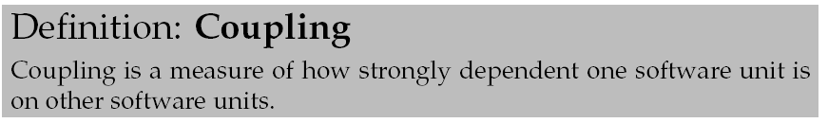
A maintainability measure
Coupling (da: kobling):
unit = a well delimited unit of code: class, package, module, method, application, etc.
Low/loose coupling: few dependencies
High/tight coupling: lot of dependencies

Slide 18
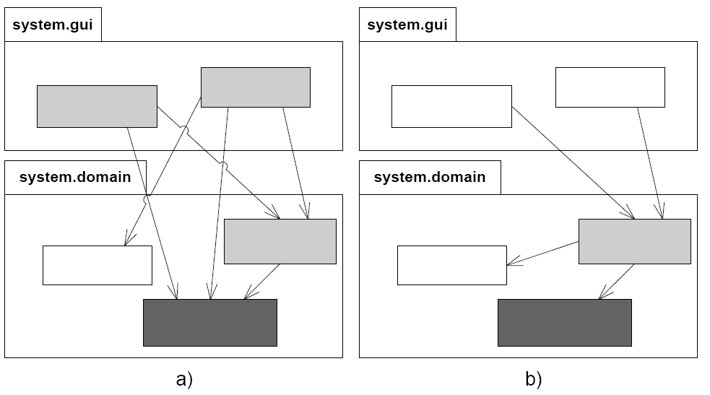
Example

Slide 19
Exercise
Name some language constructs or techniques that generate dependencies between two classes.
?
Notes:
objec references
global access to variables
database access
method calls
formats on Data
interpretations on data

Slide 20
War story
In the ABC research project, a knowledge based system was able to guess at human activities based on knowledge of location of objects in a hospital setting.
For instance co-location of a medicine tray, a nurse and a patient would trigger a ”the patient is receiving medicine” activity proposal.
The ID used in the knowledgebase was RFID tag ID.
Later, some programmer changed ID for persons to CPR identity instead ☺.

Slide 21
Rule of Thumb:
Not that surprising:
Assign responsibility so coupling is low
Because
Local change has no/less impact
Easier to understand modules in isolation
Higher probability of reuse with few dependencies

Slide 22
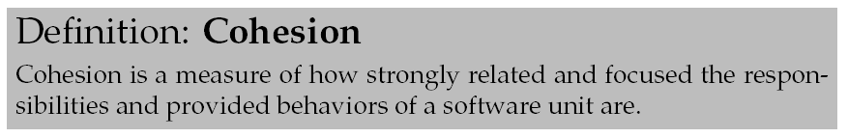
Cohesion
Cohesion (da: kohæsion/binding/samhørighed):
Example:
Unit X: all classes that begin with letters A, B, and C
Unit Y: all classes related to booking a flight seat

Slide 23
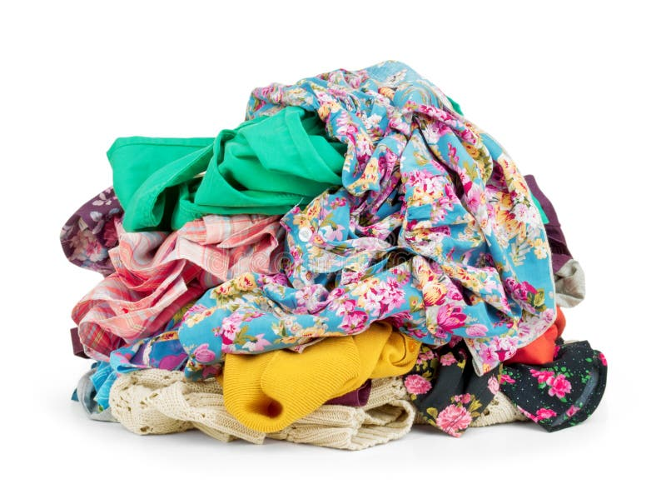
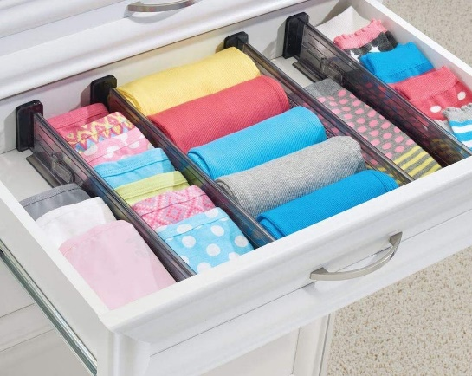
Rule of Thumb
Also not surprising:
Assign responsibility so cohesion is high
Related stuff are grouped together…
High/Low

Slide 24
Discussion
Maintainable software generally has weak coupling and high cohesion.
Weak coupling means one change does not influence all other parts of the software
lowering cost of change
High cohesion means that a change is likely localized in a single subsystem, easier to spot
lowing the cost of change
But remember – they are means to an end
Not the end by itself. Maintainable software is the goal!

Slide 25
Law of Demeter
A very concrete “law” that addresses the coupling measure is Law of Demeter:
Do not collaborate with indirect objects
Also known as
Don’t Talk to Strangers
Example from HotStone

Slide 26
Lieberherr
Within a method, messages should only be sent to
this
a parameter of the method
an attribute of this
an element of a collection which is an attribute of this
an object created within the method
In other words: “never two or more dot’s in a call” ☺
(unless you use the object manager / service locator pattern, in which case you are allowed exactly two dots ☺)

Slide 27
War story
Major Danish IT company
problem: dynamic configuration of user interface elements
solution:
configuration parameters in property file
read at run-time
if ( dialogX.panelY.listboxZ.color == NONE ) { ...}
☹

Slide 28
Then what?
Rule of Thumb:
Assign the responsibility to the client’s direct object to do the collaboration with indirect objects
Thus
order.getItem(3).getPrice().addTax()
should be replaced by
order.addTaxToItem(3);
Consequences
☺ Law of Demeter lowers direct coupling
☹ Interfaces may bloat with too many method

Slide 29
Summary
Analyzable software is less costly to maintain
Maintainability is basically a cost measurement
Measured in number of staff hours to do X = cost
Easy to create Spaghetti code but costly in the long run
Technical Debt: Get feature now and pay later
But remember to clean up quickly or the debt will increase
Maintainable software is the goal
Means are to strive for
Clean code
high cohesion
… and low coupling…

